Slide 1
Infectious Diseases
TUBERCULOSIS AND OTHER BACTERIAL INFECTIOUS DISEASES

Slide 2
Tuberculosis
Tuberculosis is caused by bacteria (Mycobacterium tuberculosis) that most often affect the lungs. Tuberculosis is curable and preventable.
Tuberculosis has been known to mankind for a long time.
It is believed that the genus Mycobacterium was present in the environment about 150 million years ago, and an early variant of M. tuberculosis was originated in East Africa about 3 million years ago.

Slide 3
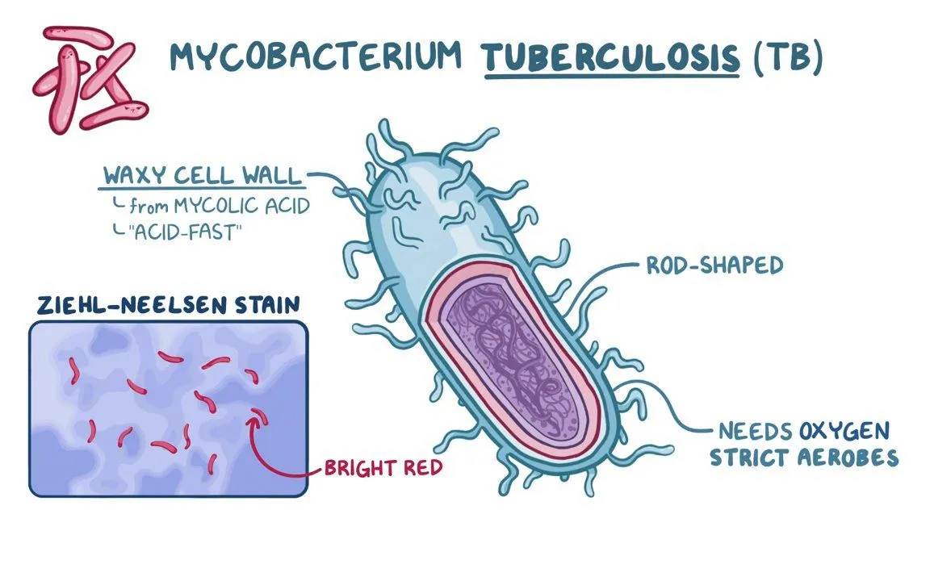

Slide 4
Tuberculosis- Locations
Tuberculosis has spread worldwide.
In 2020, the 30 high Tuberculosis burden countries accounted for 86% of new TB cases.
Eight countries account for two thirds of the total, with India leading the count, followed by China, Indonesia, the Philippines, Pakistan, Nigeria, Bangladesh and South Africa.

Slide 5
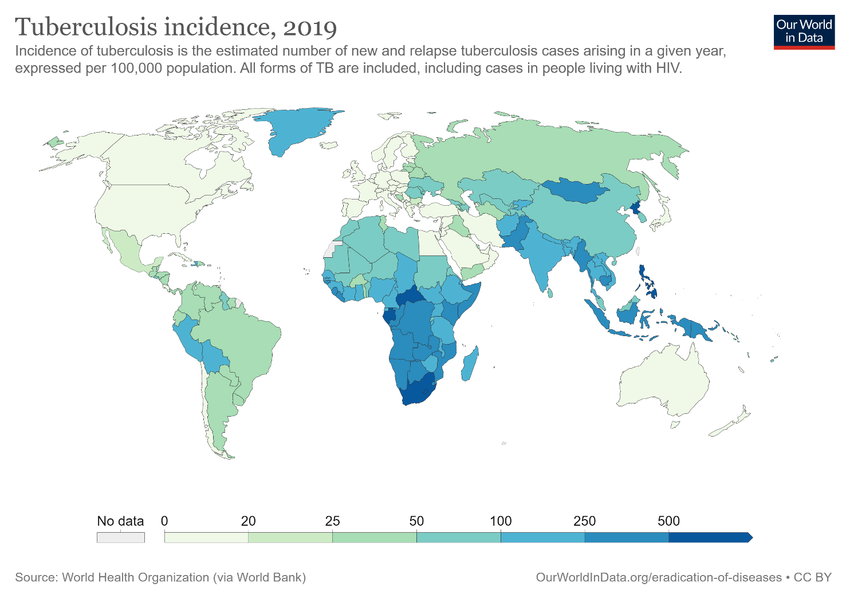

Slide 6
Tuberculosis- Outbreak
Once rare in developed countries, tuberculosis infections began increasing in 1985, partly because of the emergence of HIV, the virus that causes AIDS.
HIV weakens a person's immune system, so it can't fight the Tuberculosis virus.

Slide 7
Tuberculosis- Fatality Rate
A total of 1.5 million people died from TB in 2020 (including 214 000 people with HIV). Worldwide, TB is the 13th leading cause of death and the second leading infectious disease killer.
In 2020, an estimated 10 million people fell ill with tuberculosis (TB) worldwide. 5.6 million men, 3.3 million women and 1.1 million children. TB is present in all countries and age groups. But TB is curable and preventable.
In 2020, 15% of people with Tuberculosis DIED

Slide 8
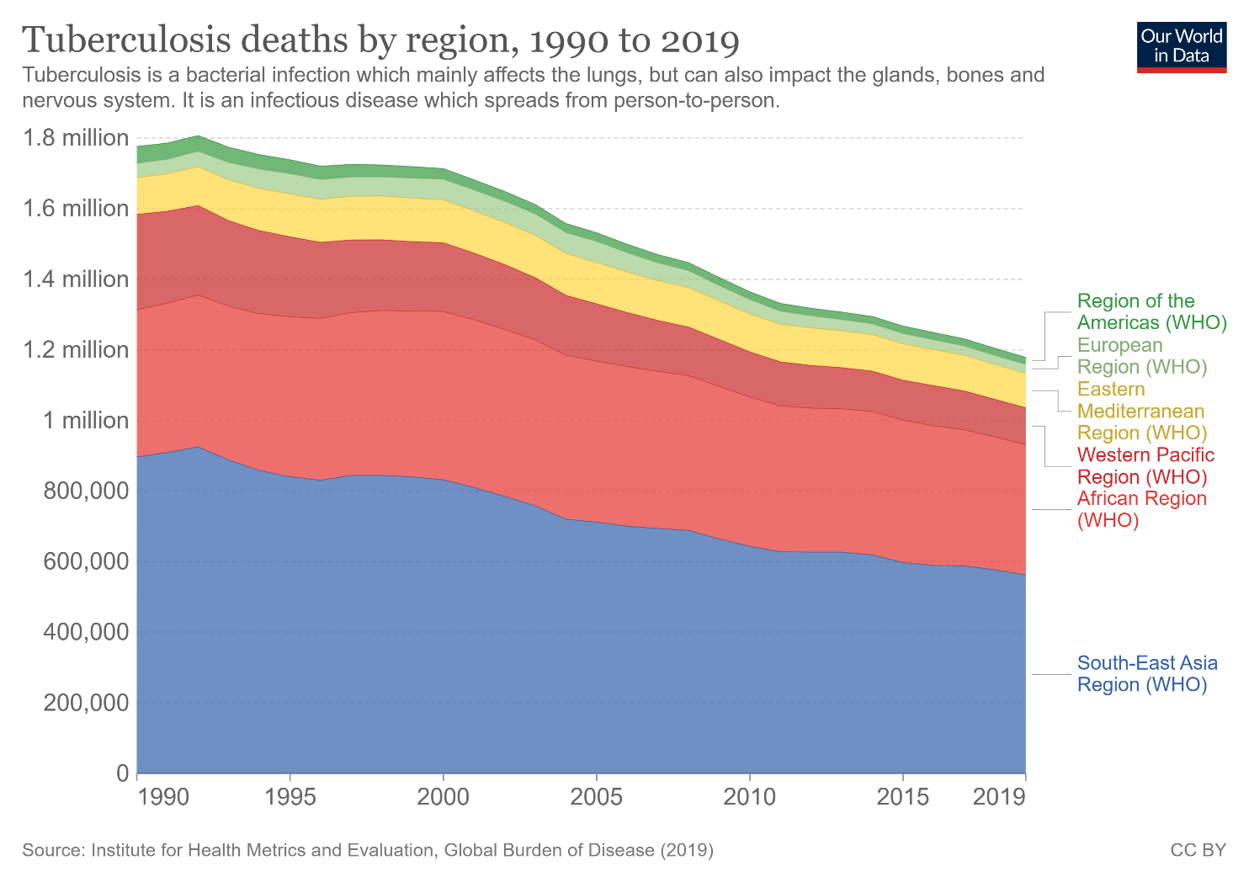

Slide 9
Tuberculosis- Spread
The bacteria that cause tuberculosis are spread from person to person through tiny droplets released into the air via coughs and sneezes.
A person needs to inhale only a few of these germs to become infected.

Slide 10
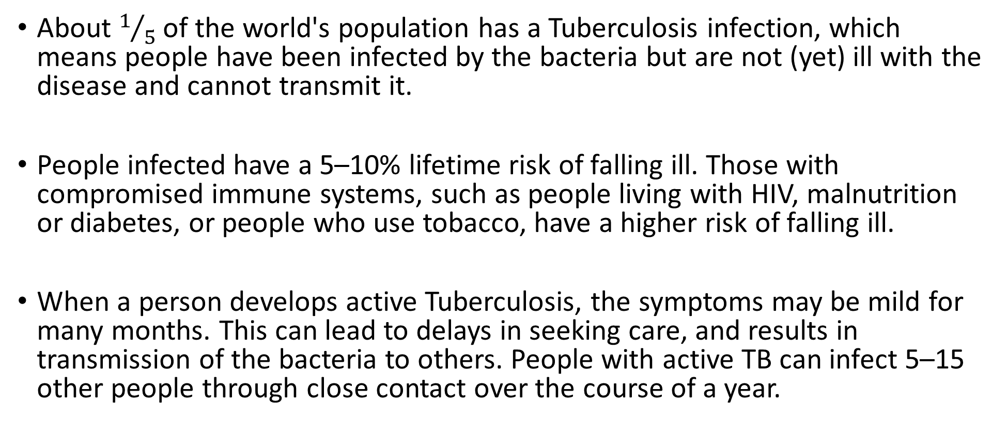
Tuberculosis- Spread
About $1/5$ of the world's population has a Tuberculosis infection, which means people have been infected by the bacteria but are not (yet) ill with the disease and cannot transmit it.
People infected have a 5–10% lifetime risk of falling ill. Those with compromised immune systems, such as people living with HIV, malnutrition or diabetes, or people who use tobacco, have a higher risk of falling ill.
When a person develops active Tuberculosis, the symptoms may be mild for many months. This can lead to delays in seeking care, and results in transmission of the bacteria to others. People with active TB can infect 5–15 other people through close contact over the course of a year.

Slide 11
Tuberculosis – Who is at risk?
Tuberculosis mostly affects adults. However, all age groups are at risk.
Over 95% of cases and deaths are in developing countries.
People who are infected with HIV are 18 times more likely to develop active Tuberculosis. The risk of active Tuberculosis is also greater in people suffering from other conditions that impair the immune system. People with undernutrition are 3 times more at risk.
Alcohol use disorder and tobacco smoking increase the risk of Tuberculosis.

Slide 12
Tuberculosis- Treatment
Common symptoms of active Tuberculosis are cough with sputum and blood at times, chest pains, weakness, weight loss, fever and night sweats.
Diagnosing multidrug-resistant and other resistant forms of Tuberculosis as well as HIV-associated Tuberculosis can be complex and expensive.
Tuberculosis is particularly difficult to diagnose in children.

Slide 13
Resistant Tuberculosis
Many tuberculosis strains resist the drugs most used to treat the disease.
People with active tuberculosis must take many types of medications for months to get rid of the infection and prevent antibiotic resistance.
Multidrug-resistant Tuberculosis remains a public health crisis and a health security threat. Only about one in three people with drug resistant Tuberculosis accessed treatment in 2020.

Slide 14
Tuberculosis going forward
Globally, Tuberculosis incidence is falling at about 2% per year and between 2015 and 2020 the cumulative reduction was 11%.
This was over half way to the End Tuberculosis Strategy milestone of 20% reduction between 2015 and 2020.

Slide 15
Other bacterial diseases of note
Anthrax
Tetanus
Pneumonia
Cholera
Botulism
Pseudomonas Infection
Meningitis
Bubonic Plague

Slide 16
Anthrax
Anthrax is a serious infectious disease caused by gram-positive, rod-shaped bacteria known as Bacillus anthracis. It occurs naturally in soil and commonly affects domestic and wild animals around the world.
People can get sick with anthrax if they come in contact with infected animals or contaminated animal products. It is not contagious.
Thousands of animals get sick and die each year. Anthrax is very rare in people, with only a few dozen cases reported yearly (average)

Slide 17
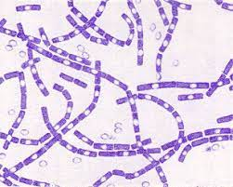


Slide 18
Tetanus
Tetanus is acquired through infection of a cut or wound with the spores of the bacterium Clostridium tetani, and most cases occur within 14 days of infection. Tetanus cannot be transmitted from person to person.
Tetanus can be prevented through immunisation
Anyone can get tetanus, but the disease is particularly common and serious in newborn babies and pregnant women who have not been sufficiently immunized with tetanus-toxoid-containing vaccines.

Slide 19
Tetanus continued.
Symptoms can include:
jaw cramping or the inability to open the mouth
muscle spasms often in the back, abdomen and extremities
Seizures and headache
fever and sweating
changes in blood pressure or fast heart rate.
Globally 38,000 people died from tetanus in 2017. Around half (49%) were younger than five years old.

Slide 20
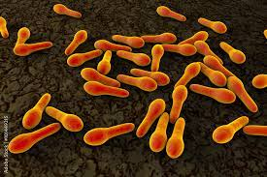
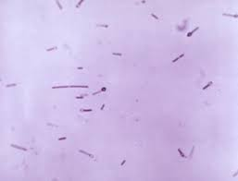

Slide 21
Pneumonia
Pneumonia is a form of acute respiratory infection that affects the lungs. Pneumonia can be caused by viruses, bacteria, or fungi.
Pneumonia can be prevented by immunisation, adequate nutrition, and by addressing environmental factors.
Pneumonia caused by bacteria can be treated with antibiotics, but only one third of children with pneumonia receive the antibiotics they need. It accounts for 14% of all deaths of children under 5 years old, killing 740 180 children in 2019

Slide 22
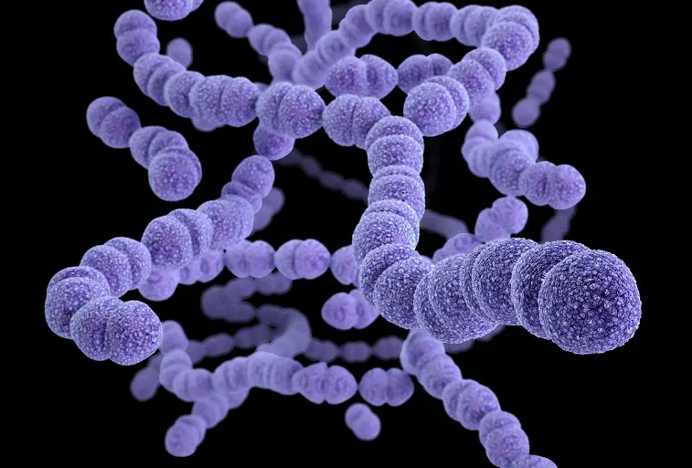

Slide 23
Cholera
Most of those infected will have no or mild symptoms and can be successfully treated with oral rehydration solution.
Cholera is an acute diarrhoeal disease caused by ingestion of food or water contaminated with the bacterium Vibrio cholera. It can kill within hours if left untreated. Severe cases will need rapid treatment with intravenous fluids and antibiotics.
Provision of safe water and sanitation is critical to prevent and control the transmission of Cholera.

Slide 24
Cholera
Researchers have estimated that each year there are 1.3 to 4 million cases of Cholera, and 21 000 to 143 000 deaths worldwide due to Cholera (2010-2016)
Oral Cholera vaccines should be used in conjunction with improvements in water and sanitation to control Cholera outbreaks and for prevention in areas known to be high risk for Cholera.
Cholera remains a global threat to public health and an indicator of inequity and lack of social development.

Slide 25
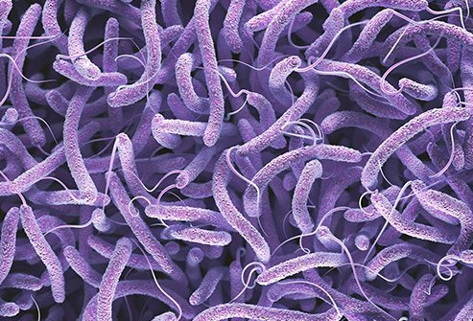

Slide 26
Botulism
Clostridium botulinum is a bacterium that produces dangerous toxins (botulinum toxins) under low-oxygen conditions.
Botulinum toxins are one of the most lethal substances known.
Botulinum toxins block nerve functions and can lead to respiratory and muscular paralysis.

Slide 27
Botulism
Foodborne botulism, caused by consumption of improperly processed food, is a rare but potentially fatal disease if not diagnosed rapidly and treated with antitoxin.
Homemade canned, preserved or fermented foodstuffs are a common source of foodborne botulism and their preparation requires extra caution.
The bacterium C. botulinum is the same bacterium that is used to produce Botox, a pharmaceutical product predominantly injected for clinical and cosmetic use.

Slide 28
Botulism
In 2017, there was 182 confirmed cases of Botulism, with 4 deaths in USA
Botulinum toxins pose a major threat as biological weapons because they are extremely potent and lethal; some of the toxins are relatively easy to produce and transport; and people with botulism require prolonged intensive hospital care.

Slide 29
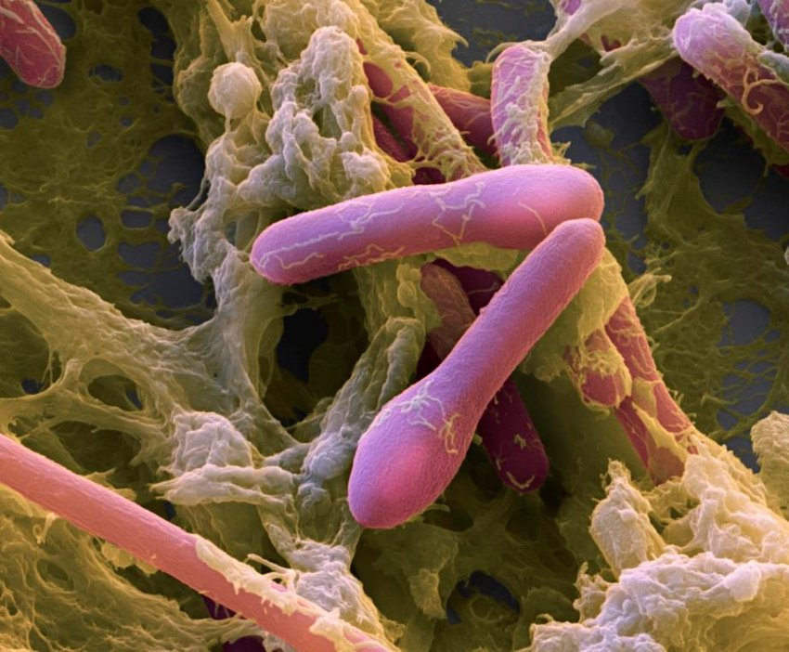

Slide 30
Pseudomonas Infection
Pseudomonas infections are caused by a kind of bacteria called Pseudomonas that’s commonly found in soil, water, and plants. Some healthy people even have strains of it growing on their skin in moist parts of their body, like their armpits or genital area.
If you’re in good health, you could come into contact with pseudomonas and not get sick or only get a mild skin rash, ear or eye infection. But if you’re sick or your immune compromised, Pseudomonas can cause a severe infection that may be life threatening.

Slide 31
Pseudomonas Infection
You can get Pseudomonas from contaminated fruits and vegetables, and moist areas like pools, hot tubs, bathrooms, kitchens, and sinks.
The most severe infections occur in hospitals. Pseudomonas can easily grow in humidifiers and types of medical equipment -- catheters, for instance -- that aren’t properly cleaned.

Slide 32
Pseudomonas Infection
In 2017, multidrug-resistant Pseudomonas aeruginosa caused an estimated 32,600 infections among hospitalised patients and 2,700 estimated deaths in the United States

Slide 33
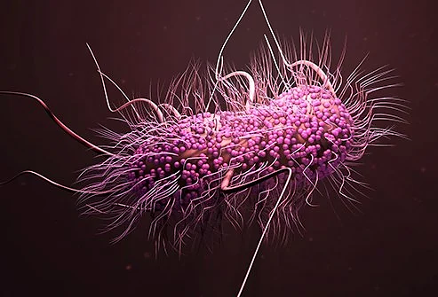

Slide 34
Meningitis
Meningitis is a devastating disease. Many organisms can cause meningitis including bacteria, viruses, fungi, and parasites. Bacterial Meningitis is of particular concern. Around 1 in 10 people who get this type of Meningitis die and 1 in 5 have severe complications.
Meningitis remains a major global public-health challenge. Epidemics of Meningitis are seen across the world, particularly in sub-Saharan Africa.
Vaccines are the most effective way to deliver long-lasting protection.

Slide 35
Meningitis
Most bacteria that cause Meningitis such as meningococcus, pneumococcus and Haemophilus influenzae are carried in the human nose and throat. They spread from person to person by respiratory droplets or throat secretions.
112 205 children under the age of 5 died from Meningitis in 2019.
In 2021 an estimated 2.5 million cases of Meningitis occurred globally, with approximately 250,000 deaths.

Slide 36
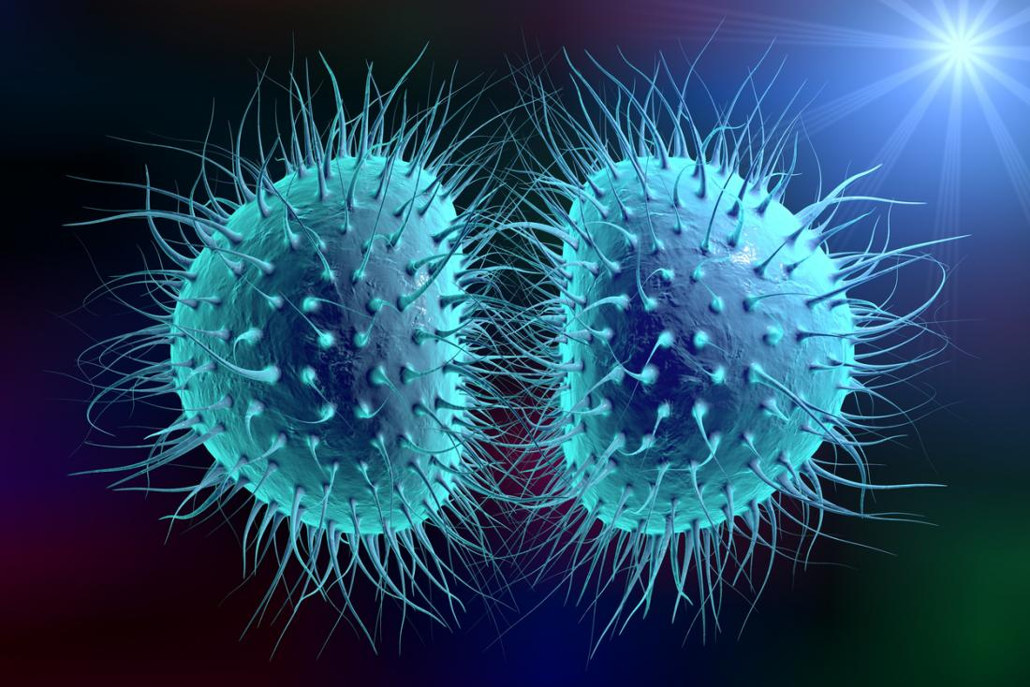

Slide 37
Bubonic Plague
Bubonic plague is an infection caused by a specific type of bacterium called Yersinia pestis. It can affect humans and animals and is spread mainly by fleas. Called the Black Death, it killed millions of Europeans during the Middle Ages.
Prevention doesn’t include a vaccine, but does involve reducing your exposure to mice, rats, squirrels and other animals that may be infected.

Slide 38
Bubonic Plague
Bubonic plague still occurs throughout the world and in the U.S., with cases in Africa, Asia, South America and the western areas of North America.
About seven cases of plague happen in the U.S. every year on average.
There was a large outbreak in Madagascar in 2017, where there were 2,348 confirmed, probable and suspected cases and 202 deaths.

Slide 39
